Slide 1


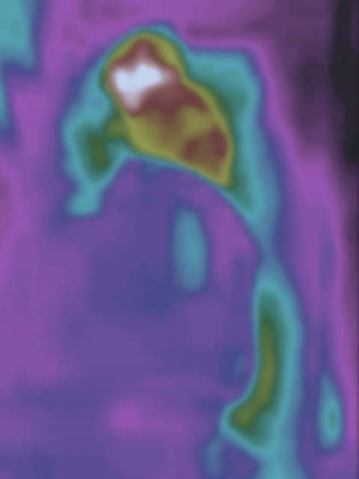






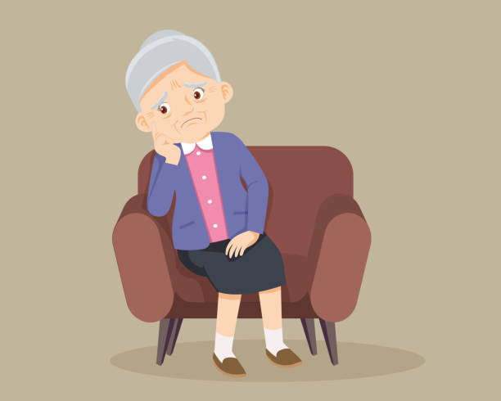




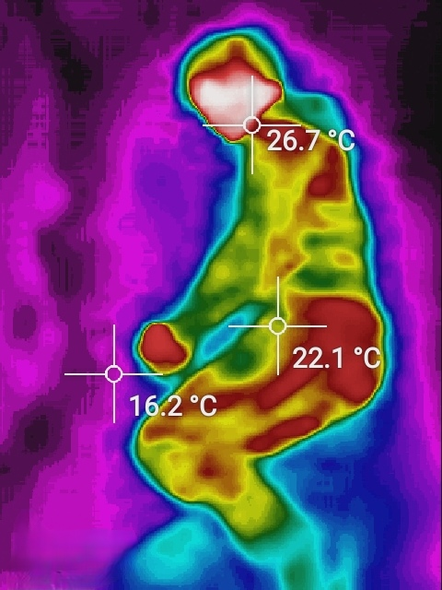




AIoT&IR camera Bedroom System
Au Ka Long
GitHub Link
YouTube Link
Aim
Application
AI and IoT technology to improve Elderly’s life by enhancing bedroom/sleeping environment
Actions | Case1(When) | Case2(When)
Call ambulance | High fever/ Hypothermia | Fall out of bed and fainted
Control air-con | Optimal body temperature | Optimal bed temperature
Care service | Not able to sleep | Possible diseases
Objective
Cozy bedroom
Wipe out the threads for Elderly
Reduce labour cost for elderly care
Background & Motivation
More To Go
Safe and Cozy environment
Continuous monitor
Healthy sleep
Can customize for different cases
Sudden Death in sleep
Imperfect of sleeping environment
Lack of labour for elderly care
~33% Elderly people living alone
Location
Nursing Home
Reduce number of nurse required
Less cost than hiring a nurse
Homes
Take care of solitary elderly
Take care of elderly when they are sleeping(cannot be cover by human)
Methodology
Conclusion
Detect the status of Person
Control Devices by the status
Fit within elderly’s preferences
Conclusion
Ensure bedroom safety
40% of household injuries
Suit elderly’s situations
All automatic
Cater elderly’s needs
Non-stop care
Object detection
Gesture analysis
Thermal analysis
Extend the system
Include other living spaces
E.g. Living room, corridors, etc.
IR camera
Temperature
Object information
Other home IoT devices
Lights
Air-conditioner
Music box
Continuous revenues
Care-on-Call service, etc.
To Support continuous update

